Slide 1
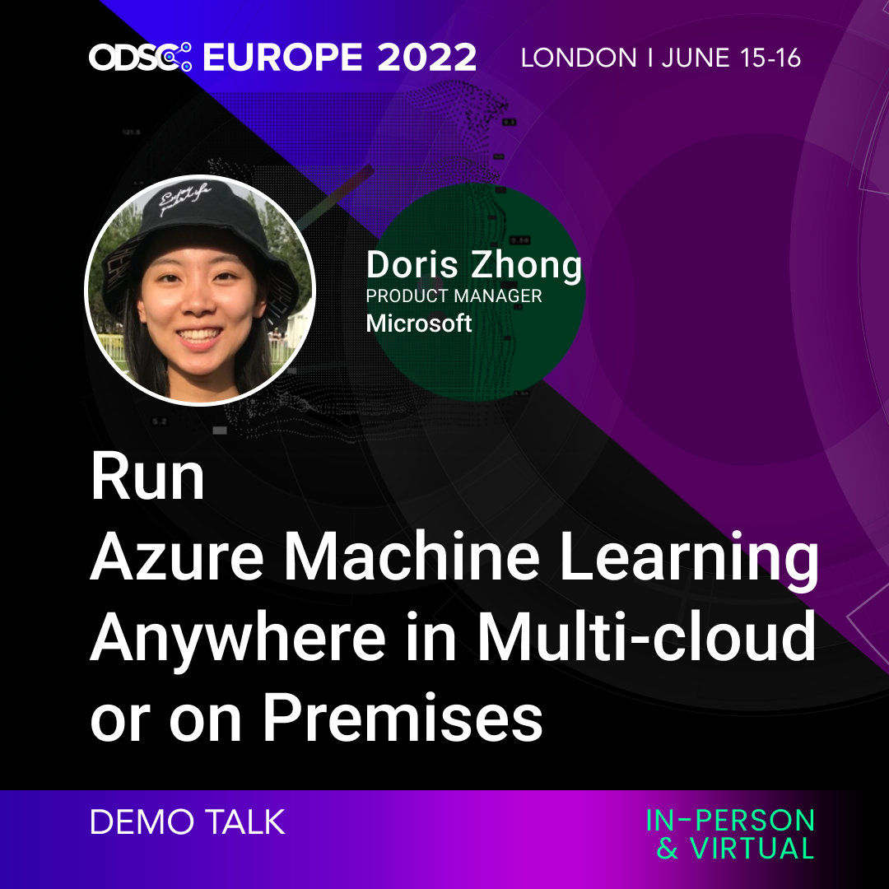


Slide 2
Session objective
In this demo session, I want to show you:
Configure AzureML extension to my Azure Arc-enabled Kubernetes cluster
Attach Kubernetes cluster to AzureML workspace
Use AzureML Designer to submit a distributed image classification GPU training job, with training data in my on-premises NFS
Deploy the trained model as online endpoint for real-time scoring

Slide 3
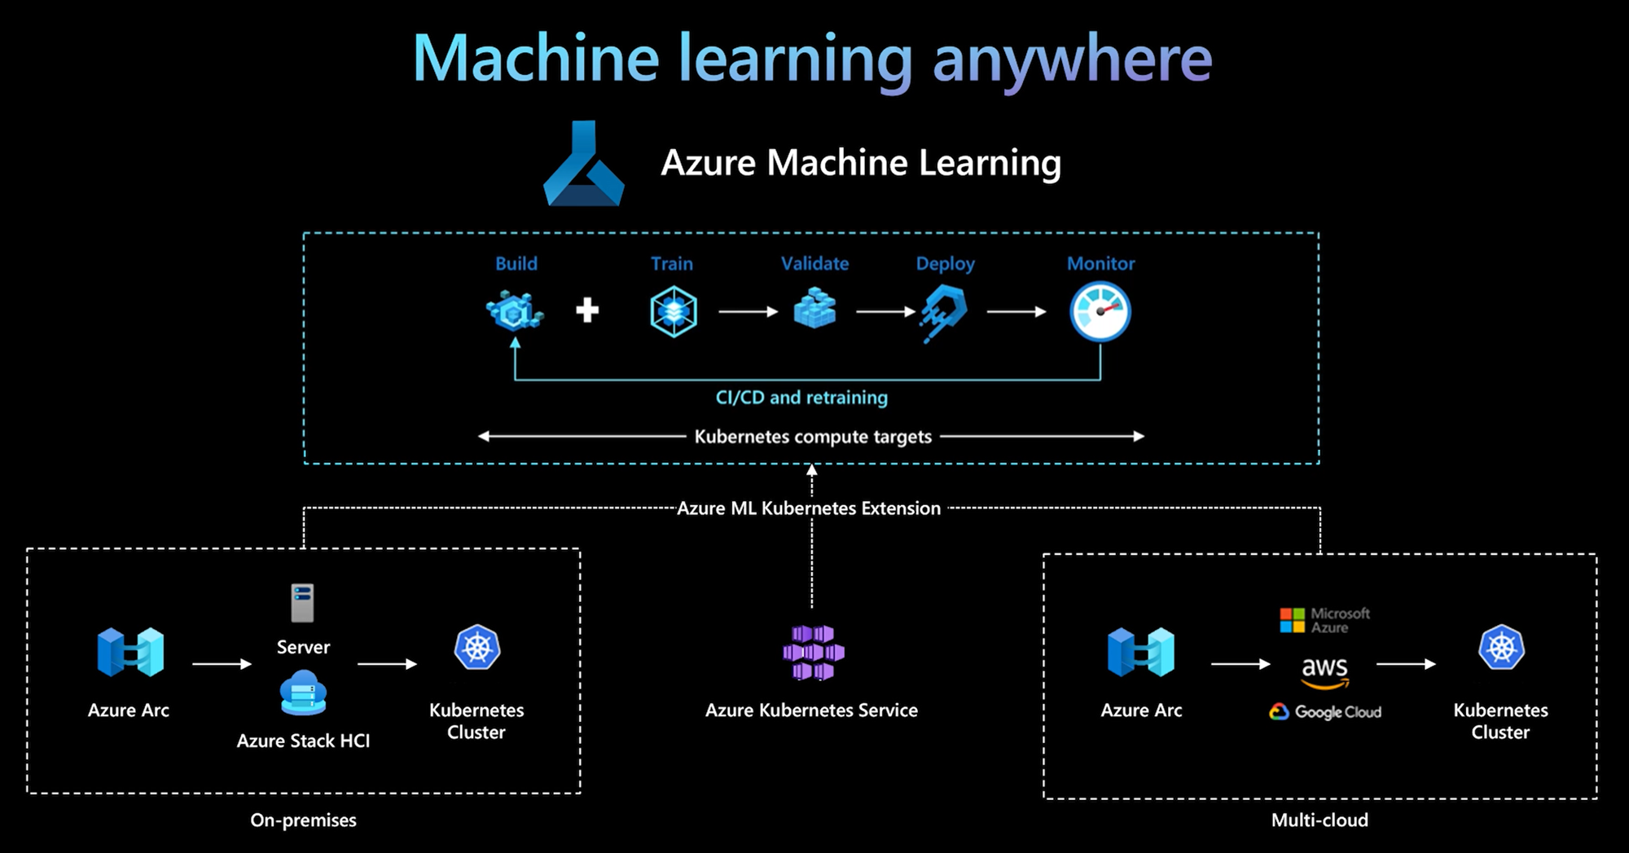
Notes:
Here are some of the capabilities that customers can benefit
Deploy ML workload on your managed AKS cluster and gain more security and controls to meet compliance requirements.
Run Azure ML workload on Arc Kubernetes cluster right where data lives and meets data residency, security, and privacy compliance, or harness existing IT investment.
Use Arc Kubernetes cluster to deploy ML workload or aspect of ML lifecycle across multiple public clouds.
Fully automated hybrid workload in cloud and on-premises to leverage different infrastructure advantages and IT investments.

Slide 4
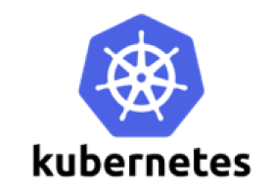
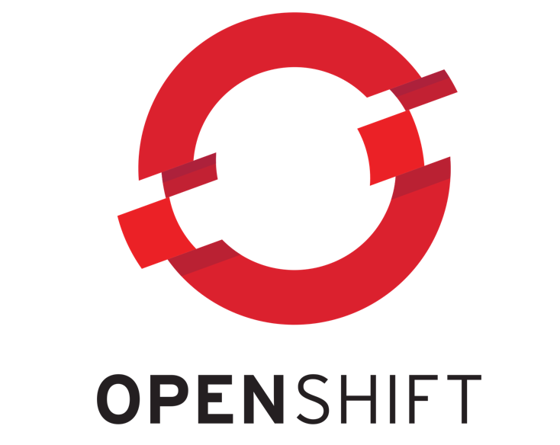

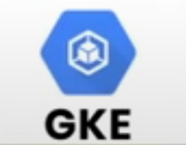


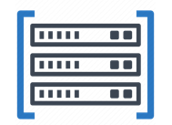
What is AzureML in Kubernetes anywhere
Seamless studio experience
Bring AzureML to your own AKS or Azure Arc-enabled Kubernetes
A unique compute target in AzureML for both training and inference
Run any ML workload with seamless AzureML experience
Notebooks
Automated ML
Designer
Responsible ML tools
Comprehensive MLOps
Reproducibility
Automation
Deployment
Re-training
Governance
Unified management across clouds and on-premises

Slide 5
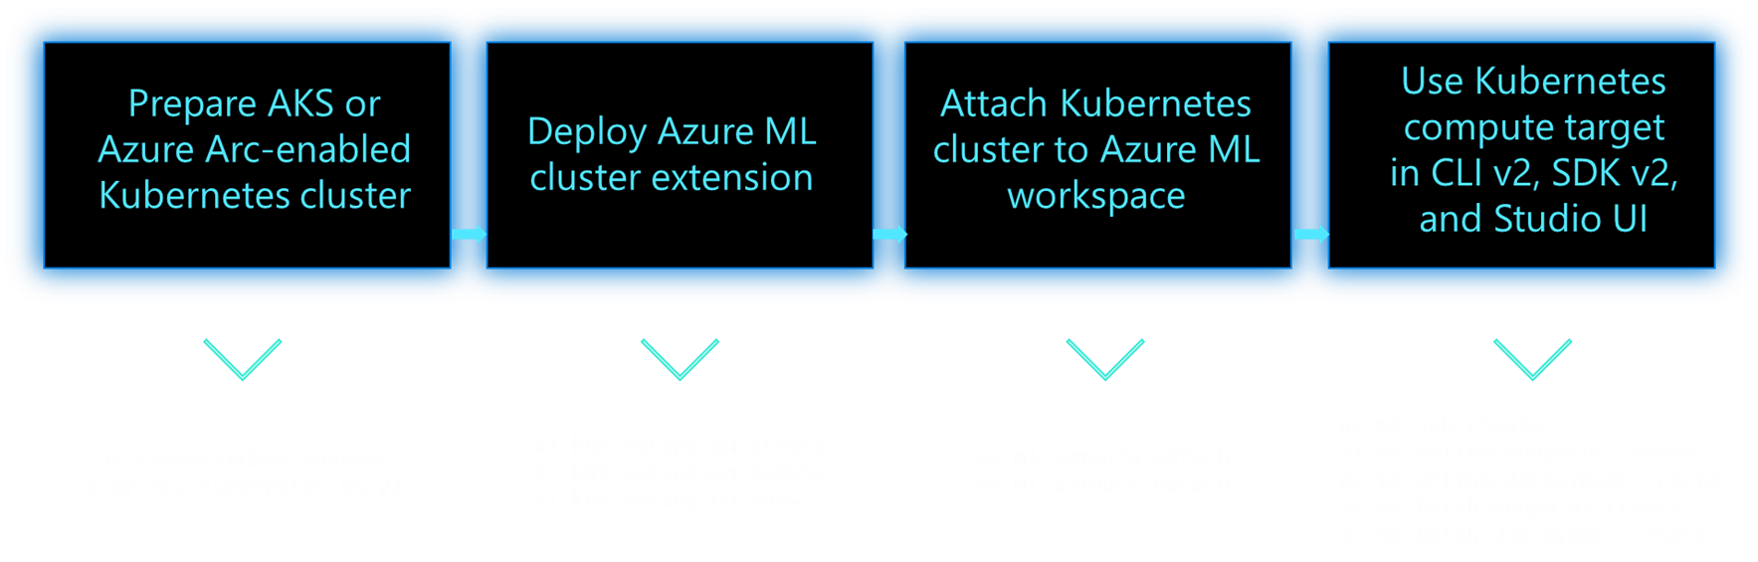
3 step - enable an exiting Kubernetes cluster for Azure ML

Slide 6
Prepare AKS or Azure Arc-enabled Kubernetes cluster
K8s Admin
K8s Admin or Data Scientist
Data Scientist
K8s Admin
Prepare AKS or Arc K8s cluster
Deploy Azure ML Extension in K8s cluster
Create a Kubernetes compute target in Azure ML Workspace
Use compute target for Azure ML training or inference
Ensure an AKS cluster is up and running in Azure
Or ensure a K8s cluster outside of Azure is up and running
Install latest Helm
Install “az connectedk8s” CLI extension
Run “az connectedk8s connect” to connect K8s cluster to Azure via Azure Arc
Install “az k8s-extension” CLI extension to be used next

Slide 7
Deploy Azure ML extension to Kubernetes cluster
K8s Admin
K8s Admin or Data Scientist
Data Scientist
K8s Admin
Prepare environment and connect Azure Arc
Deploy Azure ML Extension to K8s cluster
Create a Kubernetes compute target in Azure ML Workspace
Use compute target for Azure ML training or inference
Run “az k8s-extension create”
Use “connectedClusters” for --cluster-type if this is Arc connected cluster, use “managedClusers” if this is AKS cluster
Specify “enableTraining=True” for ML training capability, specify “enableInference=True” for ML inference capability
Pay attention to additional config settings for inference router and SSL/TLS termination if you enable inference
What does “az k8s-extension create” do?
Deploy all necessary Azure ML components on K8s cluster for ML workload lifecycle management
Deploy additional Azure resources in cloud to enable workload submission from Azure ML tooling
Check extension instance created: az k8s-extension show

Slide 8
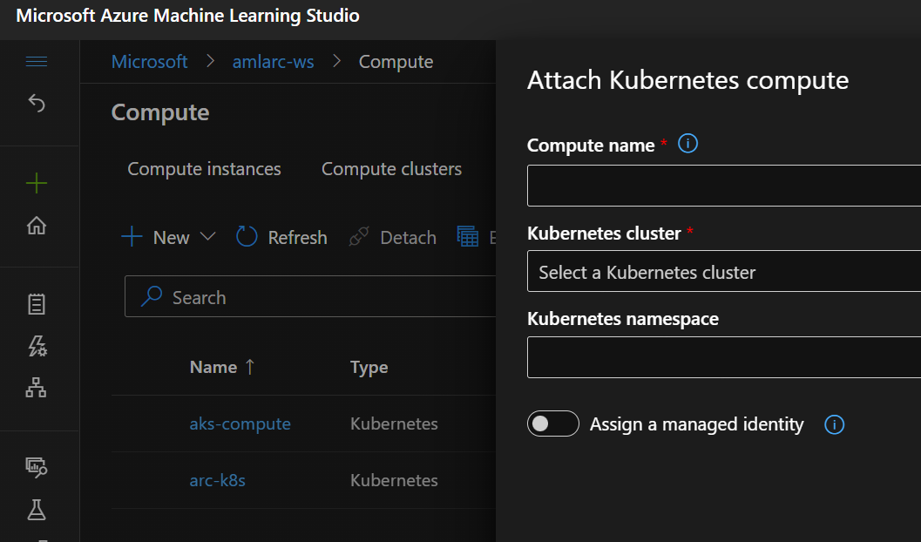
Attach Kubernetes cluster to Azure ML workspace
K8s Admin
K8s Admin
Data Scientist
K8s Admin
Prepare environment and connect Azure Arc
Deploy Azure ML Extension in K8s cluster
Attach Kubernetes cluster Azure ML Workspace
Use compute target for Azure ML training or inference
Use Azure ML CLI v2, Python SDK v2 or Studio UI to attach Kubernetes cluster
Specify manage identity to access Azure resource seamlessly from compute target
Specify K8s namespace to isolate workload (namespace must be created first in cluster)
Create instance types in K8s cluster. All instance types created in the cluster are available to the created compute target

Slide 9
Recommended best practices
Use InstanceType for compute resource efficiency
Multiple workspaces share the same K8s cluster
Workload isolation with K8s namespace
Safe production rollout with blue/green deployment

Slide 10
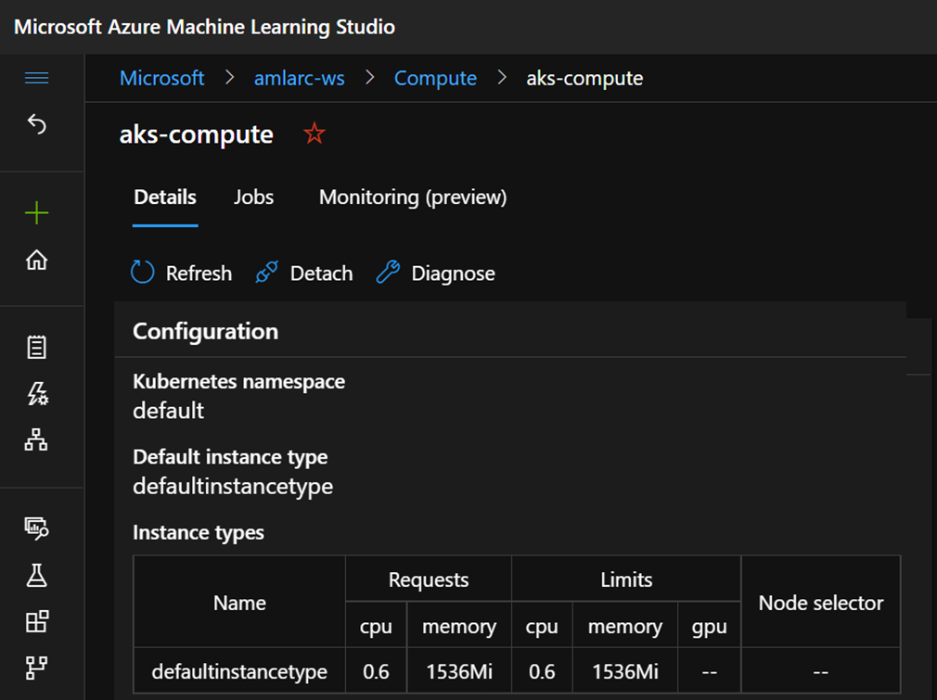
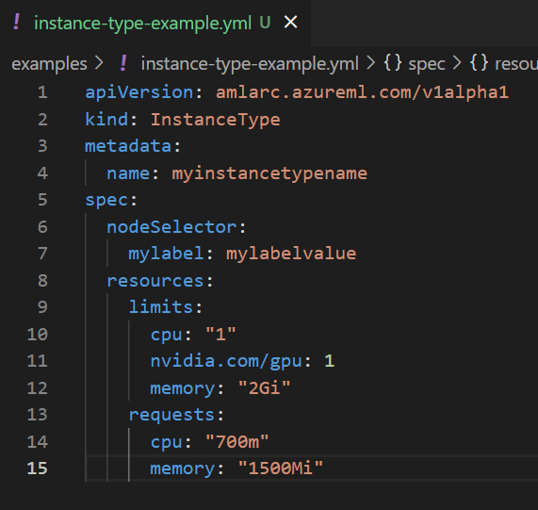
Use InstanceType for compute resource efficiency
InstanceType allows to target certain types of compute nodes and CPU/Memory/GPU resource allocation for ML workloads
InstanceType a kind of Kubernetes CRD installed by AzureML extension
A “defaultinstancetype” is created for each compute target when it is created; Always override “defaultinstancetype” to meet your workload need
Create multiple instance types to suit different kinds of workload
ML professionals can look up available instance types list in Azure ML workspace and use instance type name in job or deployment YAML

Slide 11
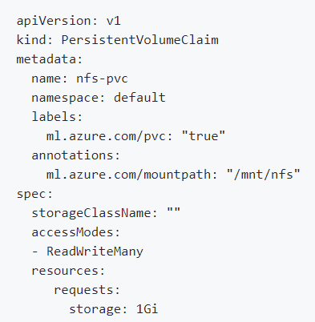
Connect with custom data sources
The training job in the same namespace with the PVC will be mounted the volume automatically. Then data scientist can access the mount path in the training job.
In Kubernetes world, PV, PVC are commonly used to manage and consume data from various storage provides, like NFS, flexVolume, Cephfs, etc.
To mount specific PVC(s) to the pod of AzureML training job, you only need to make minor change to the PVC:
Set a label “ml.azure.com/pvc:”true”, so this PVC will be recognized by AzureML workloads.
set an annotation “ml.azure.com/mountpath : <mount path>” to specify the data mount path.
Note: the PVC should be in the same namespace with AzureML workloads.
Notes:
Instance type is an unit of workload

Slide 12
Why to use Kubernetes in AzureML?
Harness existing heterogeneous or homogeneous Kubernetes cluster, with CPUs or GPUs.
Share the same Kubernetes cluster in multiple AzureML Workspaces across region.
Use the same Kubernetes cluster for different machine learning purposes, including model training, batch scoring, and real-time inference.
Secure network communication between the cluster and cloud via Azure Private Link and Private Endpoint.
Isolate team projects and machine learning workloads with Kubernetes node selector and namespace.
Target certain types of compute nodes and CPU/Memory/GPU resource allocation for training and inference workloads
Connect with custom data sources for machine learning workloads using Kubernetes PV and PVC

Slide 13
Resources
Documentation
Technical blog
GitHub repo

